Slide 1
Tata Data Visualization: Empowering Business with Effective Insights
Prepared by:
Amogh K T

Slide 2
Table of Content
Introduction
Thought Process
Revenue by Month, 2011
Top 10 Countries by Revenue and Their Quantities
Top 10 Customers by Revenue
Revenue by Country

Slide 3
Introduction
Hello and welcome. In this presentation, I will take you through our company’s sales performance for the years 2010 and 2011.
I appreciate the opportunity you gave me to dive into this data to gain insightful information about the store’s performance.

Slide 4
Thought Process
I assure you that I took all the necessary steps to ensure that this analysis is accurate and correct.
Before diving into the analysis, I performed data cleaning to ensure our insights are based on error-free, high-quality data.

Slide 5
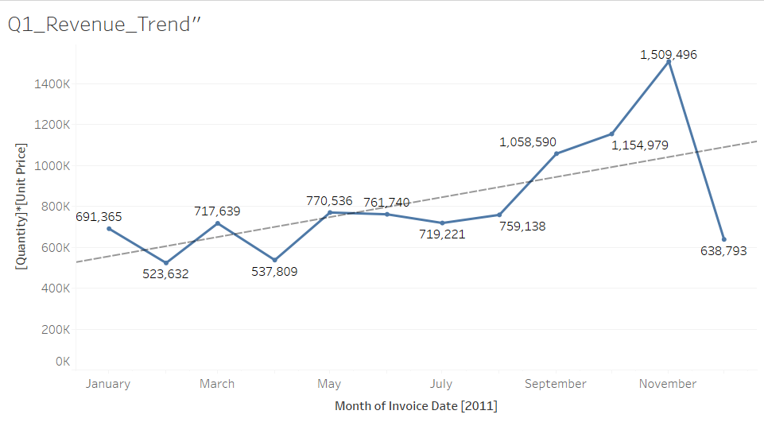
Revenue by Month, 2011
The revenue shows an overall increasing trend throughout the year, with some fluctuations
We had a significant increase in revenue from September with the revenue peaking at $1.51 Million in November and an average of 21.18% increase in revenue from August to November.
Capitalize on high-revenue periods (September-November) by increasing marketing, stock levels, and pricing strategies.
Investigate low-performing months (February, April, December) to identify potential reasons—whether it's demand fluctuations, competitive actions, or supply chain issues.

Slide 6
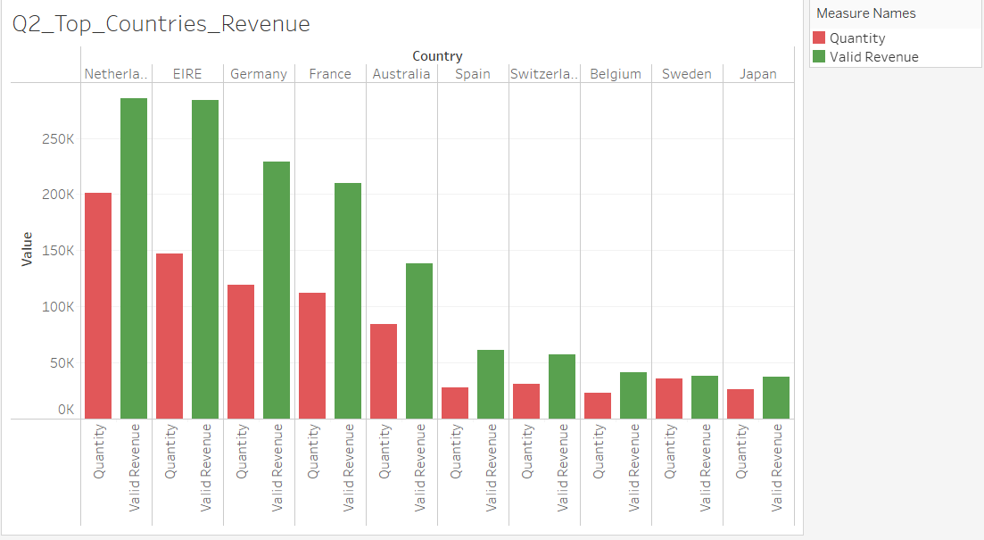
Top 10 Countries by Revenue and their Quantity
This chart represents the top 10 countries in revenue and the quantities bought in these countries except The United Kingdom.
Address Low-Performing Markets (Switzerland, Belgium, Sweden, Japan):Consider localized marketing campaigns or pricing strategies to increase sales volume.
Focus on High-Performing Markets Strengthen marketing and sales efforts in these countries to maintain and grow revenue

Slide 7
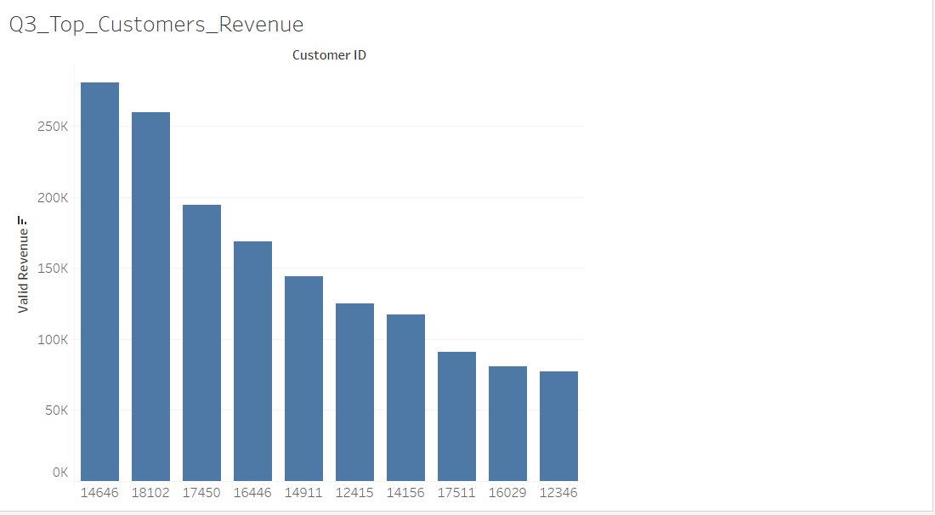
Top 10 Customers by Revenue
The chart shows that there is no major difference between the top 10 customers in terms of revenue generated.
The average difference in revenue between the top 10 customers is 15.8%.
The company can aim to strengthen the relationship with these customers to increase customer loyalty and retention, and ultimately drive more sales and revenue for the company.
Expand the Customer Base : The reliance on a few top customers can be risky. Acquiring new customers through marketing campaigns and referral programs can diversify revenue streams.

Slide 8
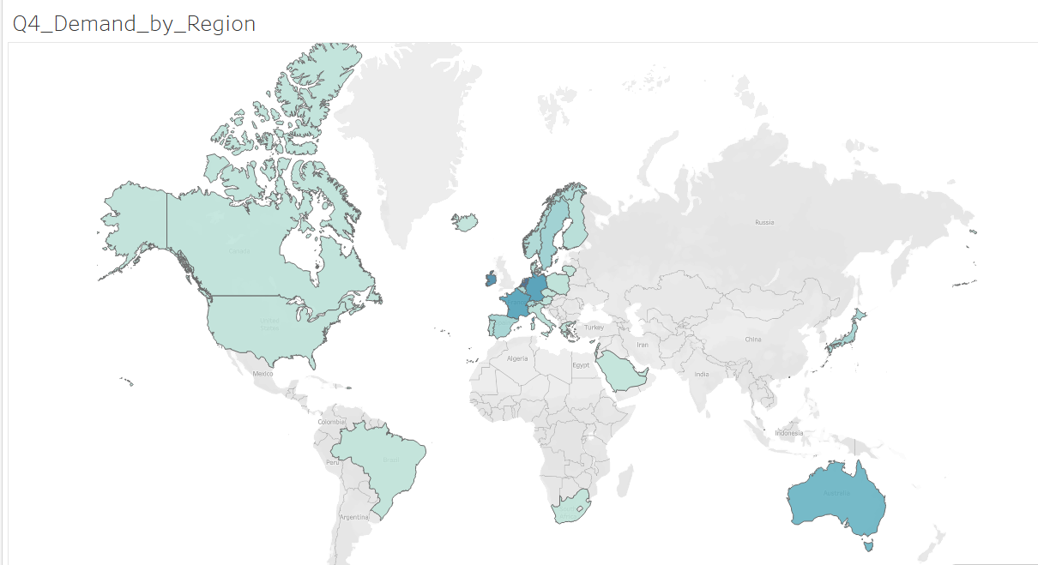
Revenue by Country
The map also reveals that the majority of sales occur only in the European zone, with only a small number in the American region
Along with Russia, there is no market for the items in Africa or Asia.
The company can concentrate on the European market more and dive deeper into countries in the region to come up with strategies that will maximize sales from each country in the region alongside Australia and Japan.
Expand into Untapped Regions : Investigate why demand is low in Asia and Africa. Assess feasibility of entering new markets through partnerships or localized operations.

Slide 9
Recommendations
The company should come up with strategies that aim at stocking and advertising seasonal products to maximize sales when the demand for these goods goes up.
The company should do a deeper analysis of products that are usually in high demand during low-sales months to come up with strategies for marketing these products.
A deeper dive into the type of products and the revenue generated from these products for each region would be key in guiding region-specific marketing strategies.
The company should consider incentivizing top revenue-generating customers to strengthen the relationship with these customers.
The European Market has more potential for growth and the company should aim at strategies that will increase its market positioning in the region.

Slide 10
THANK YOU

